Slide 1

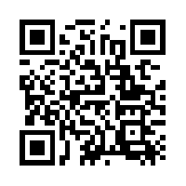
Quantum Communications Group
KML - orchestration
Group Coordinator:
Armando Nolasco Pinto
anp@ua.pt
Group Websites:
Diogo Matos
https://www.it.pt/Groups/Index/72
LinkedIn: https://www.linkedin.com/company/quantum-communications-group-it-av/

Slide 2
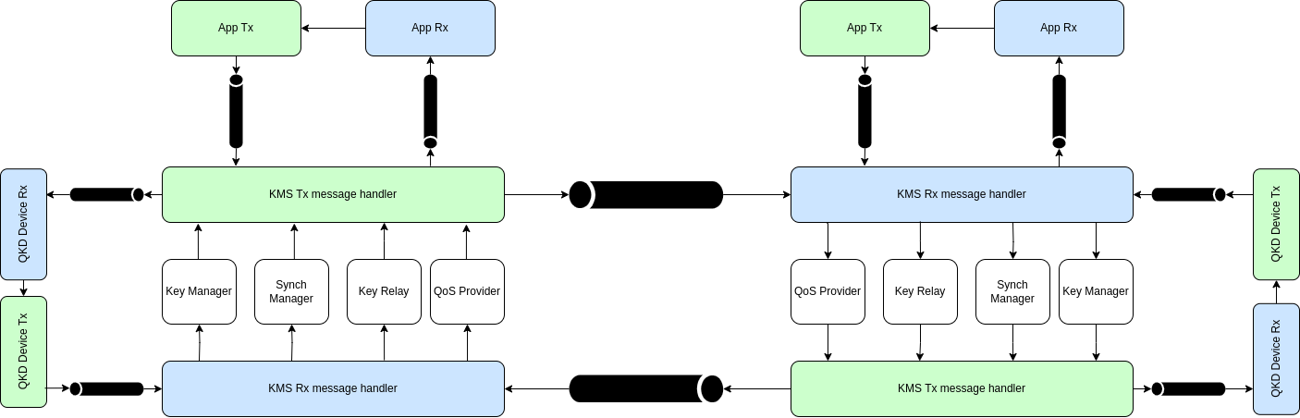
Architecture

Slide 3
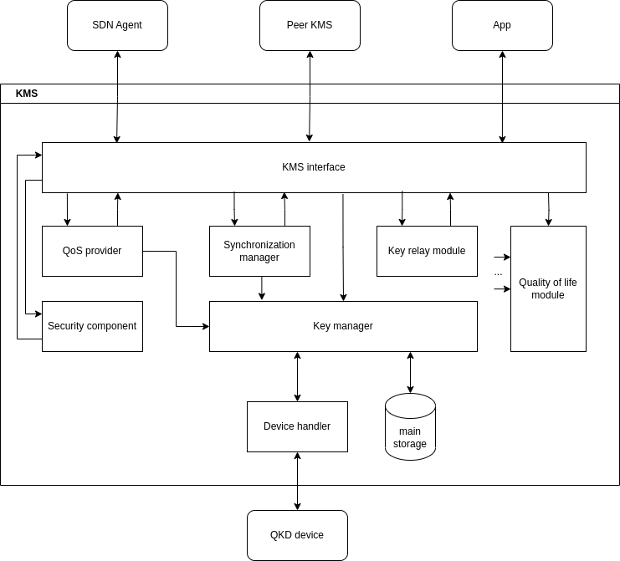
KMS architecture

Slide 4
Message format
Group | Field | Bytes | Description
Header | srcId | 32 | Unique id of the source entity
Header | msgType | 32 | Message type
Header | msgId | 8 | Sequential Id given by the source
Header | dataLength | 6 | Length of the Data field
Data | data | 5000 | Data to be transmitted

Slide 5
Message type (for basic functionality)
Source | Destination | ID | Description
APP | KMS | OPEN_CONNECT | App connect to KMS requesting the opening of a key stream
APP | KMS | GET_KEY | Request key material
APP | KMS | CLOSE | Close key stream
KMS | KMS | NEW_APP | Notify peer KMS of a new connection
KMS | KMS | NEW_KEY | For key synchronization and authentication
* | * | ACK | Acknowledge previous message

